Slide 1
Influents Automation project
Project is all about creating automation test suit for the application that is web based for the influents server.
It’s having unit test cases that is created for the each part of the project.
It covers all the functional test cases for the things also it give the result for the thing.

Slide 2
Project Planning and Project management
o Created road map for the testing and created priority test cases.
o Tested most of the functional test cases first and then created all the black box testing
o Create selenium test suite using testing framework..

Slide 3
Project coding.
o Used eclipse into the tool for the coding and used selenium RC for the creation of first level test case.

Slide 4
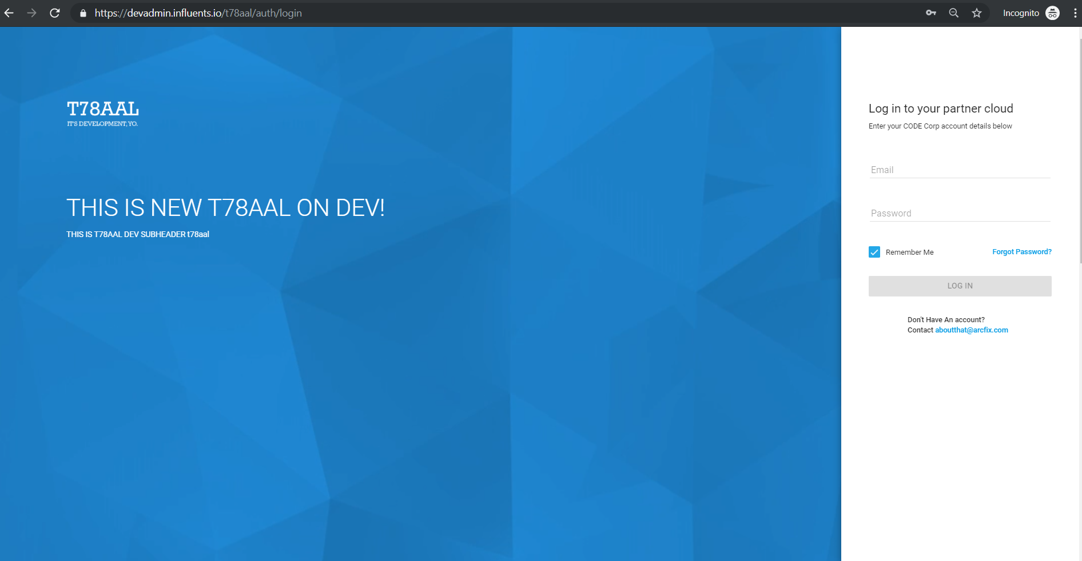
Project Screenshot with the details of the coding.

Slide 5
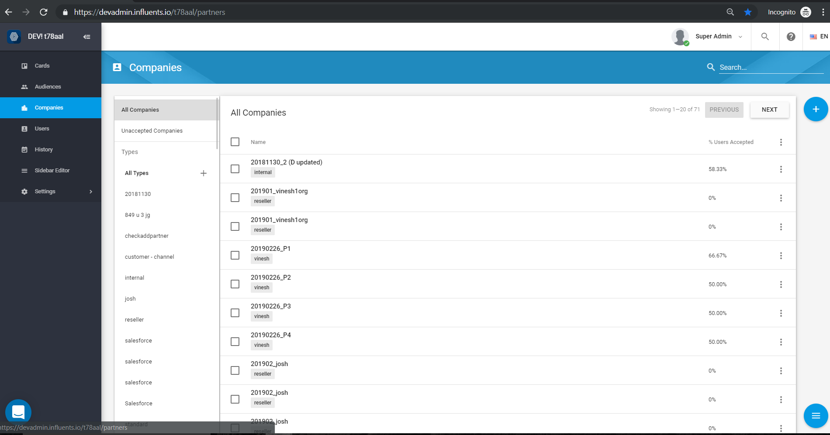
Home screen for the influents that is designed

Slide 6
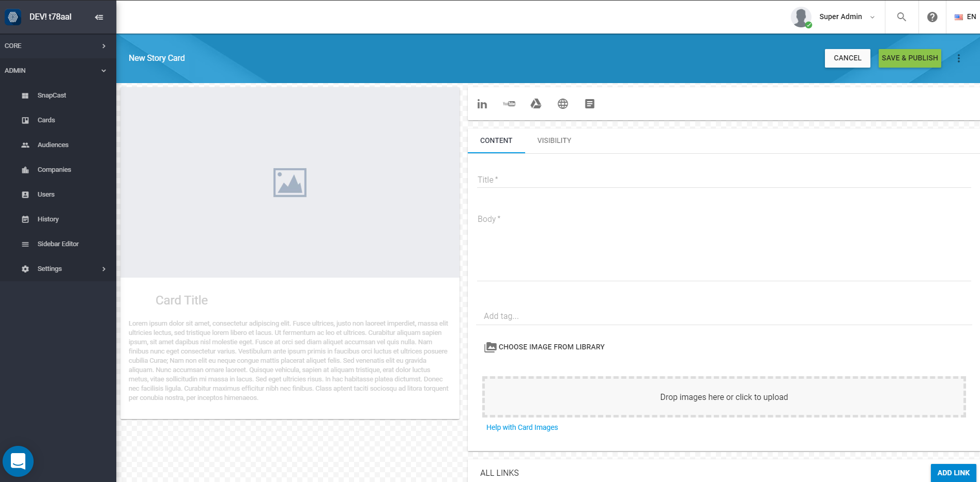
Creating new card with the automation suite. It covers main functions for the test suit.

Slide 7
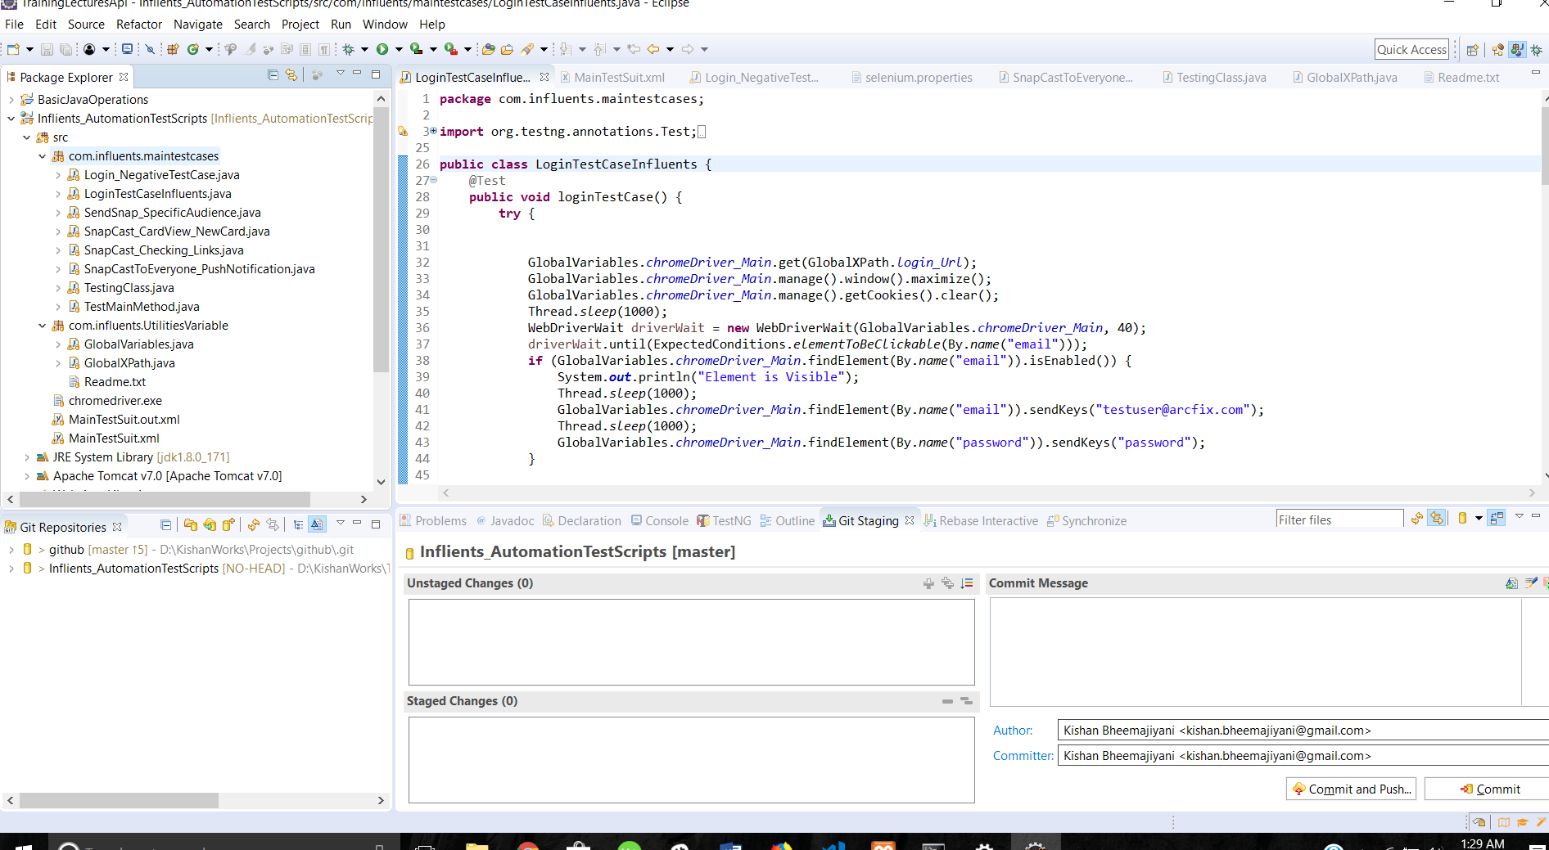
Creation of test cases using eclipse

Slide 8
Functional Testing Example
Test Planning and Test case descriptions
Login logout test case
Login with the login details user name and password
Check if user should login with proper details.
Expected output: User should login properly without issue.

Slide 9
Pushing code to the git hub.
Using architecture of team using centralized repository as git and putting one as team copy and sharing amongst the team members. Also committing final code by the repository owner
Having one staging and one production infrastructure for the same and pushing code after testing into production.

Slide 10
Code deployment into the Production
o Using Jenkins for the production release of the code into the git hub. Everyday job is running for the deploy code on staging and then Jenkins job set for the production to deploy.
o This continues for the each sprint of the cycle and after some time duration this happens all the times. So pipe line works on that way.

Slide 11
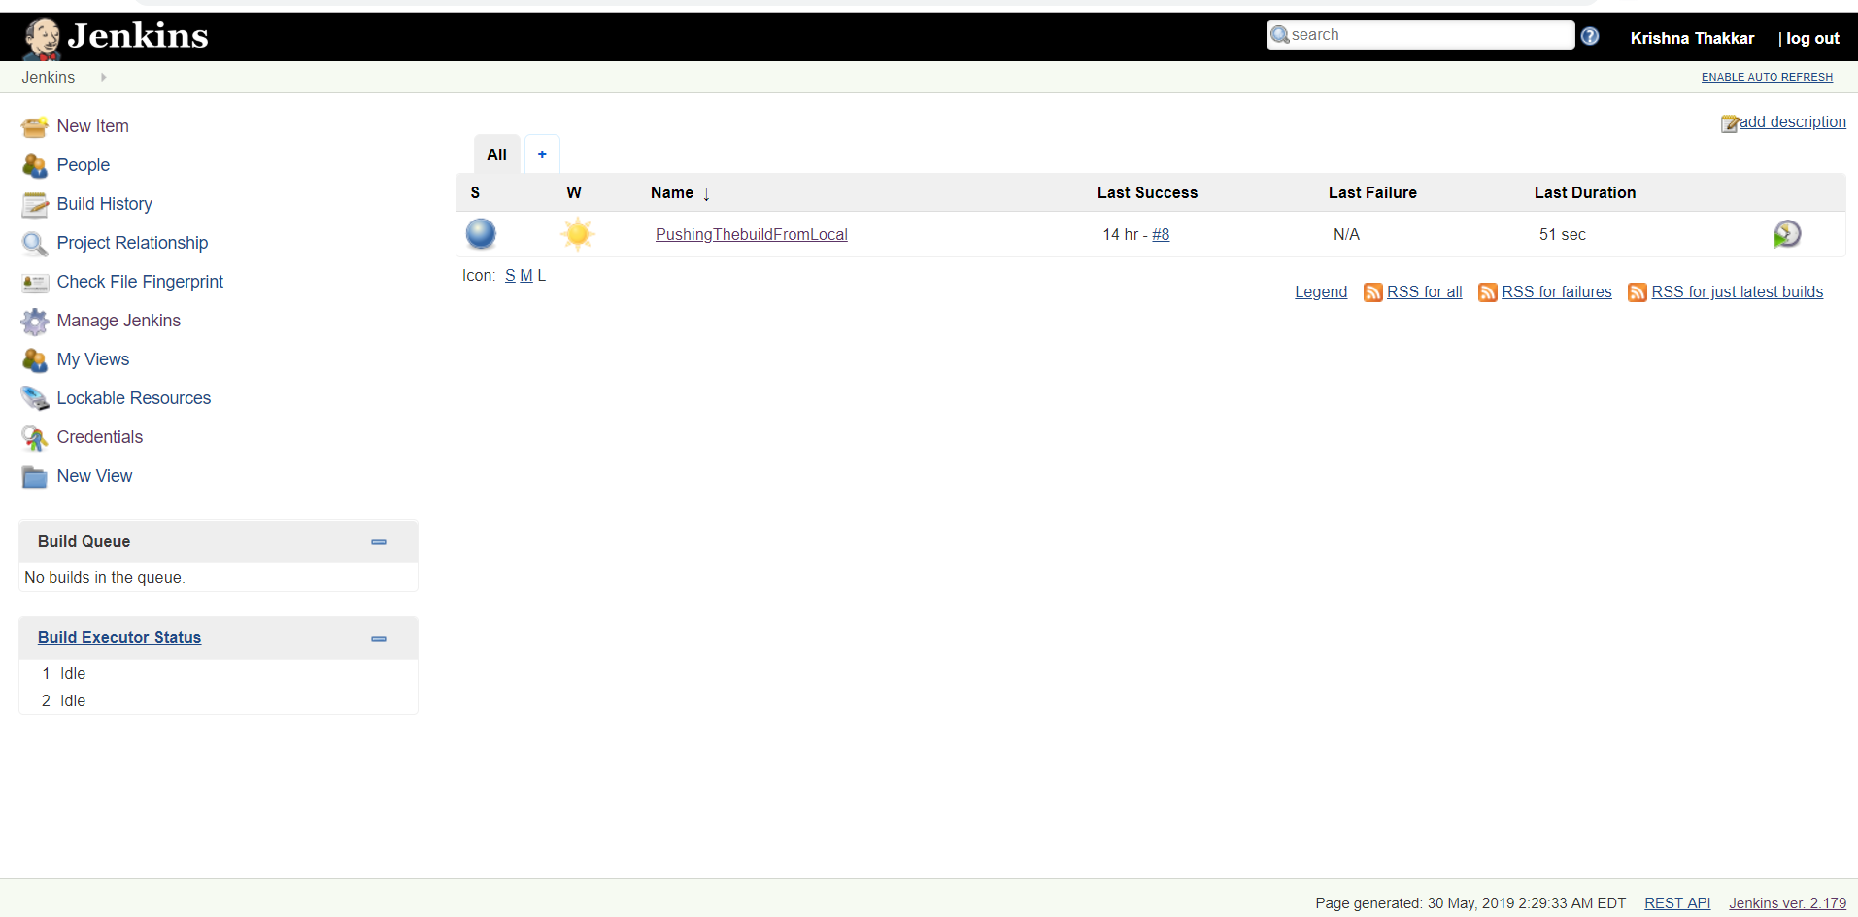
Jenkins Pipeline

